Slide 1


Summary of the Week

Slide 2
Content
1. FedCorr
2. More results with noise
3. Discussion of proof

Slide 3
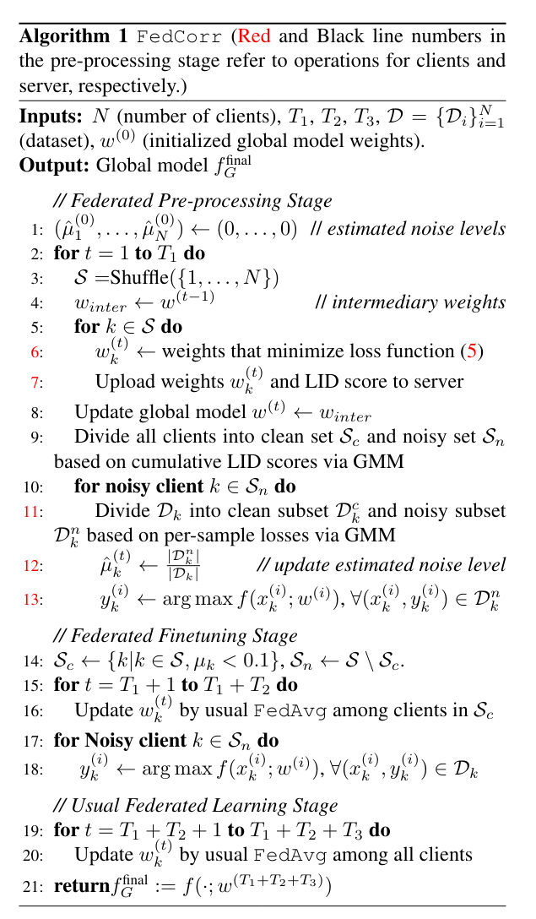
FedCorr

Slide 4
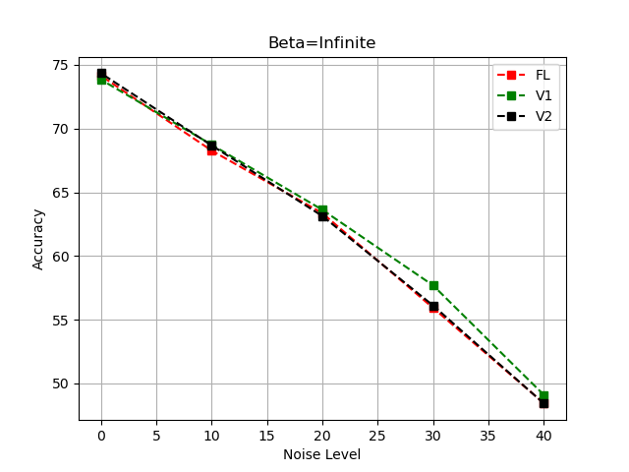
Results of Cifar10
Cifar100
N=10
Beta=infinite

Slide 5
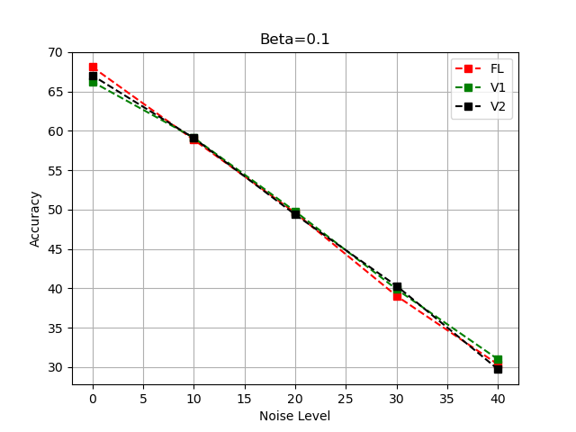
Results of Cifar10
Cifar100
N=10
Beta=0.1

Slide 6
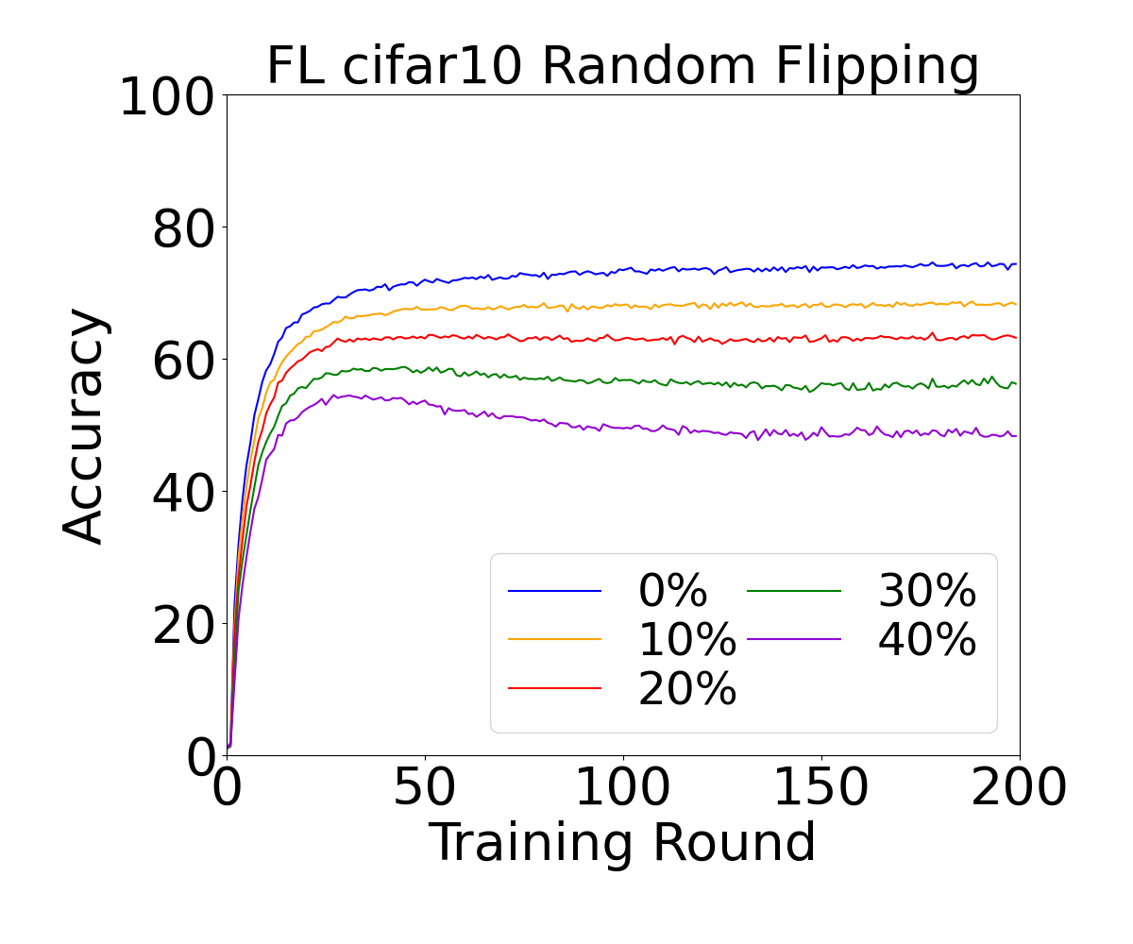
Results of Cifar10
Cifar100
N=10
Beta=infinite

Slide 7
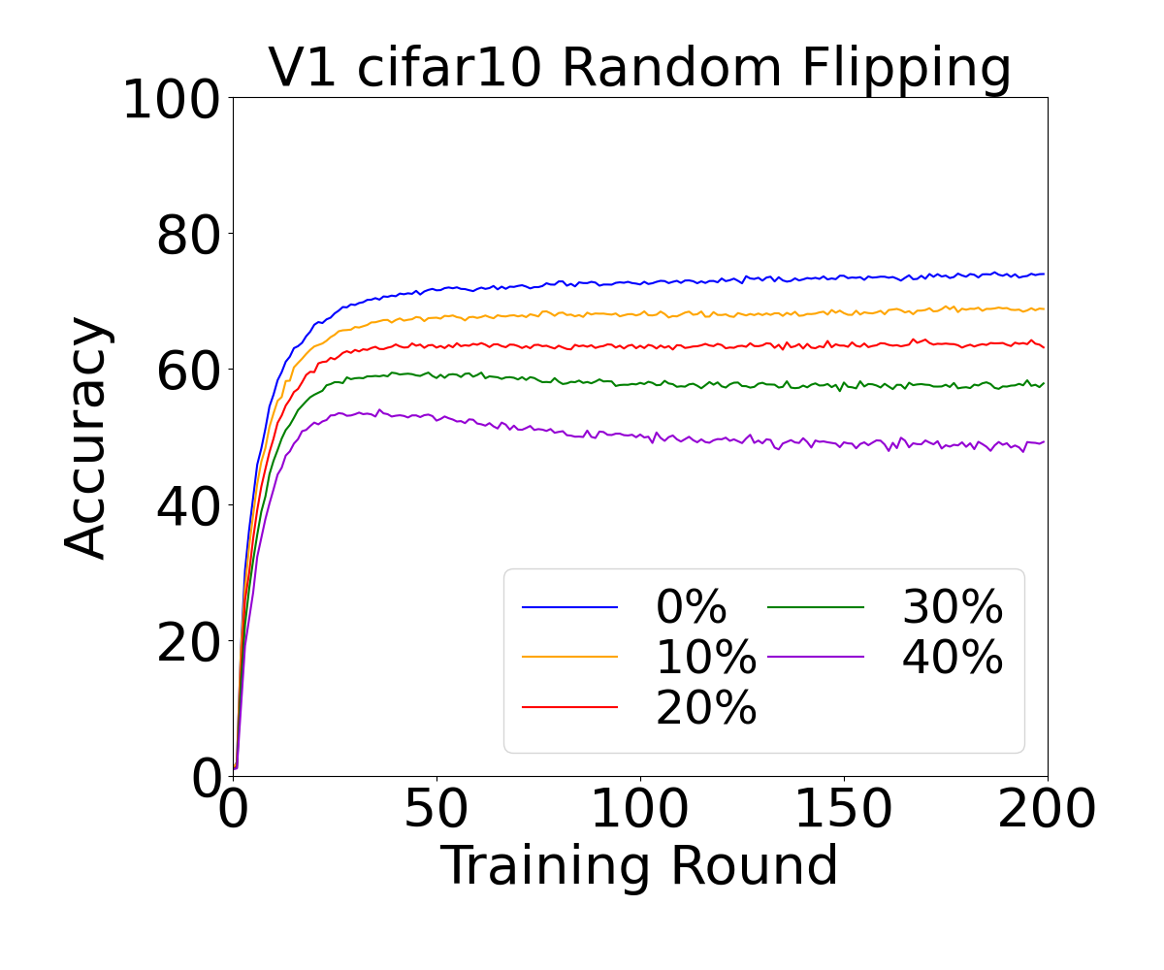
Results of Cifar10
Cifar100
N=10
Beta=infinite

Slide 8
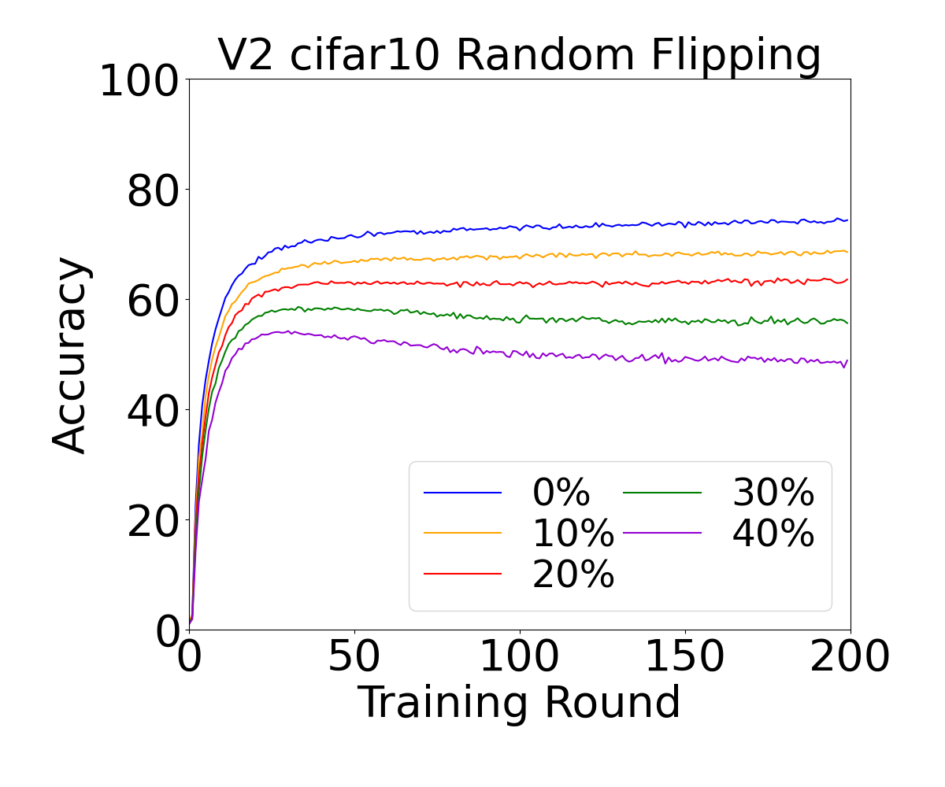
Results of Cifar10
Cifar100
N=10
Beta=infinite

Slide 9
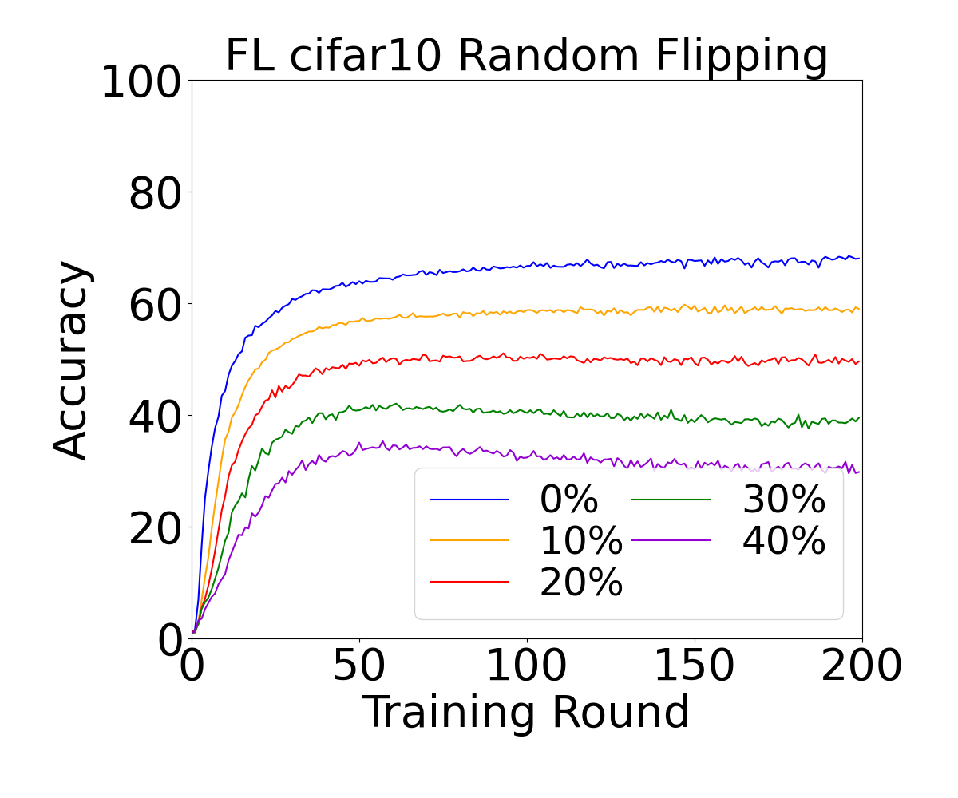
Results of Cifar10
Cifar100
N=10
Beta=0.1

Slide 10
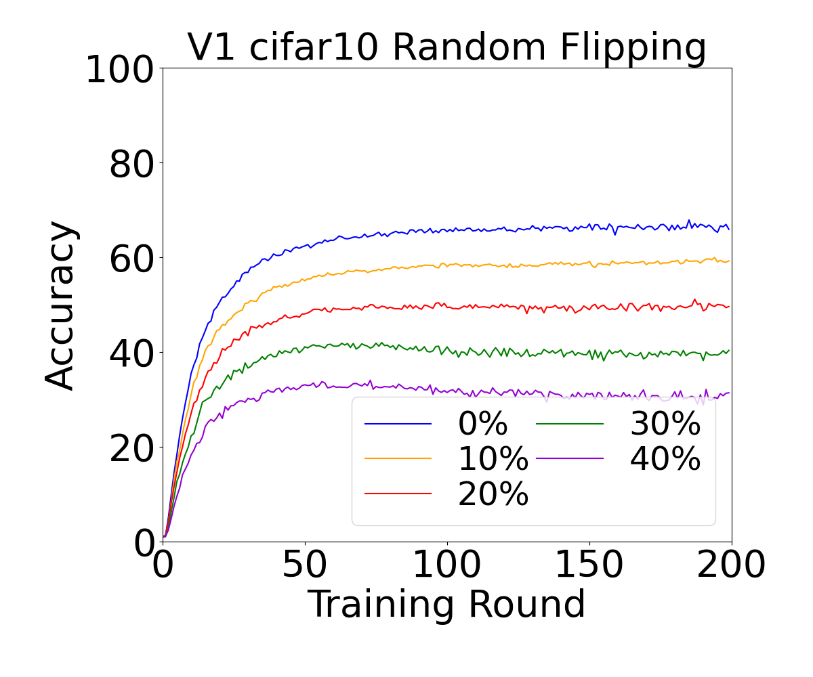
Results of Cifar10
Cifar100
N=10
Beta=0.1

Slide 11
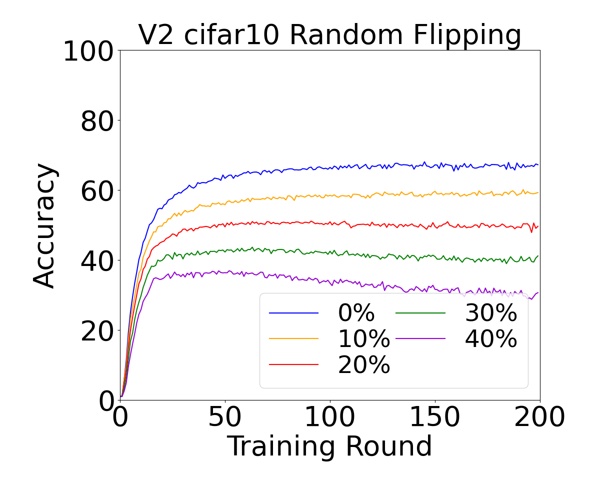
Results of Cifar10
Cifar100
N=10
Beta=0.1

Slide 12
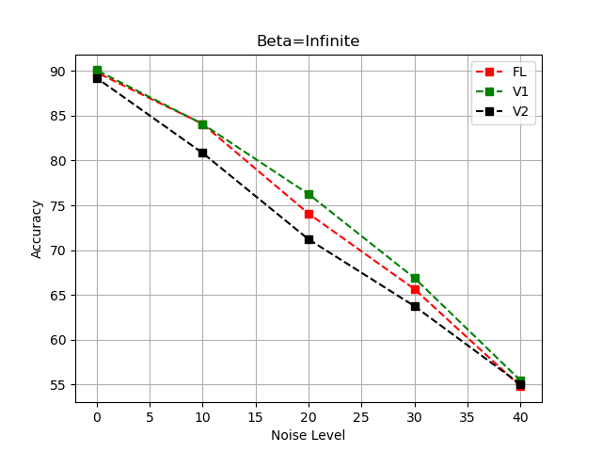
Result of Cifar10
Cifar10
N=100
Beta=infinite

Slide 13
Results of Cifar10
Cifar10
N=100
Beta=0.1

Slide 14
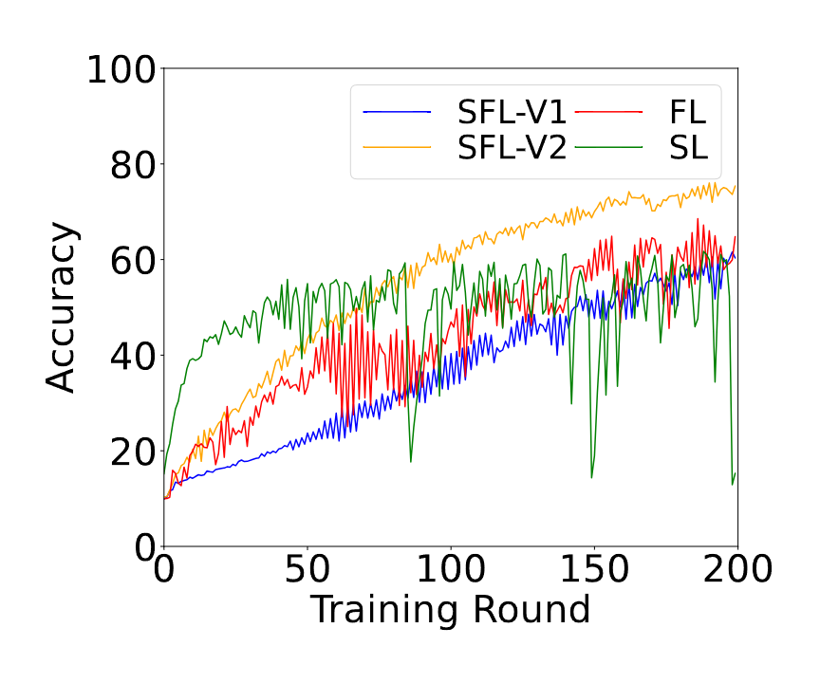
Results of Cifar10
Cifar10
N=100
Beta=0.1

Slide 15
Results of Cifar10
Cifar10
N=100
Beta=0.1

Slide 16
Results of Cifar10
Cifar10
N=100
Beta=0.1

Slide 17
Results of Cifar10
Cifar10
N=100
Beta=0.1

Slide 18
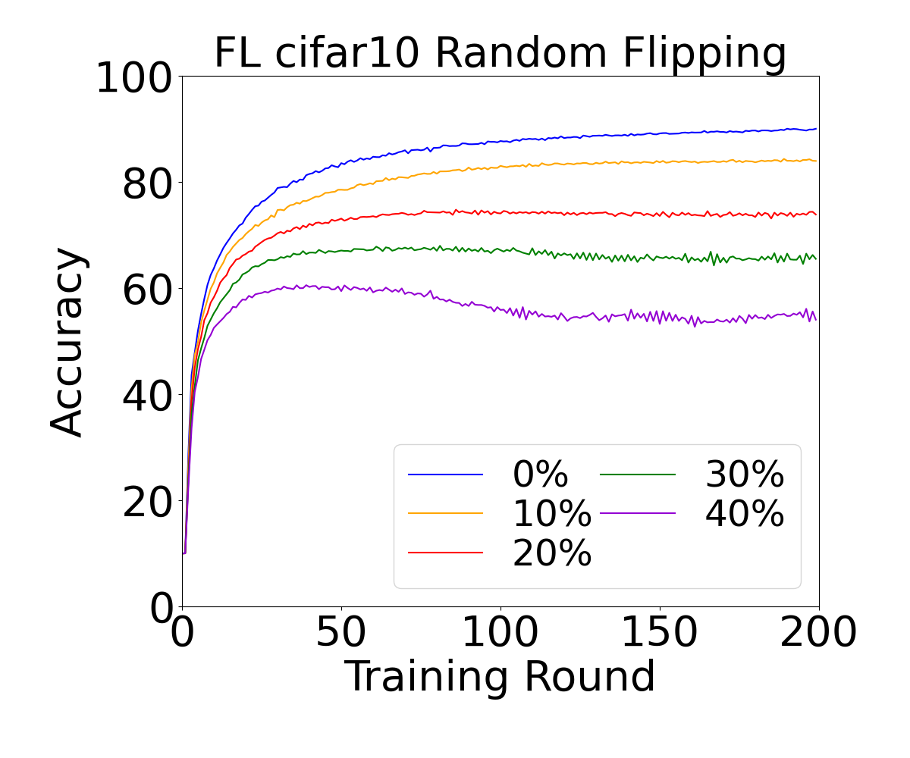
Results of Cifar10
Cifar10
N=100
Beta=infinite

Slide 19
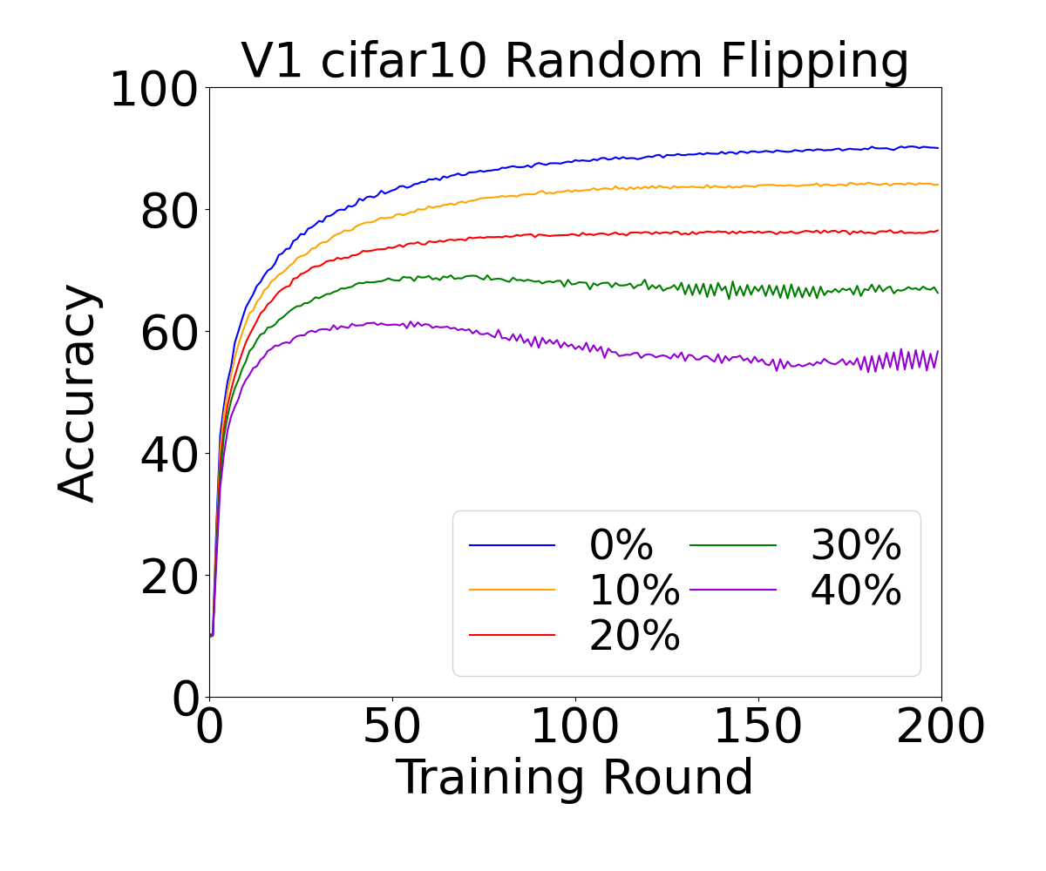
Results of Cifar10
Cifar10
N=100
Beta=infinite

Slide 20
Results of Cifar10
Cifar10
N=100
Beta=infinite

Slide 21
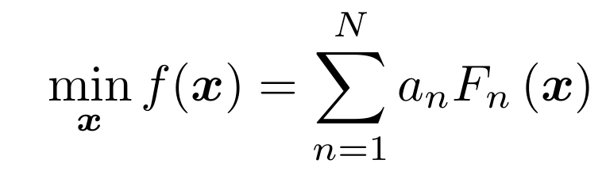
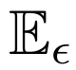
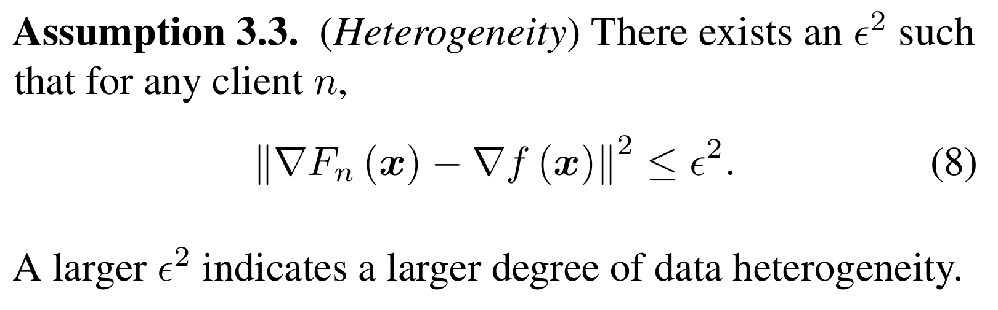
Non-convex

Slide 22
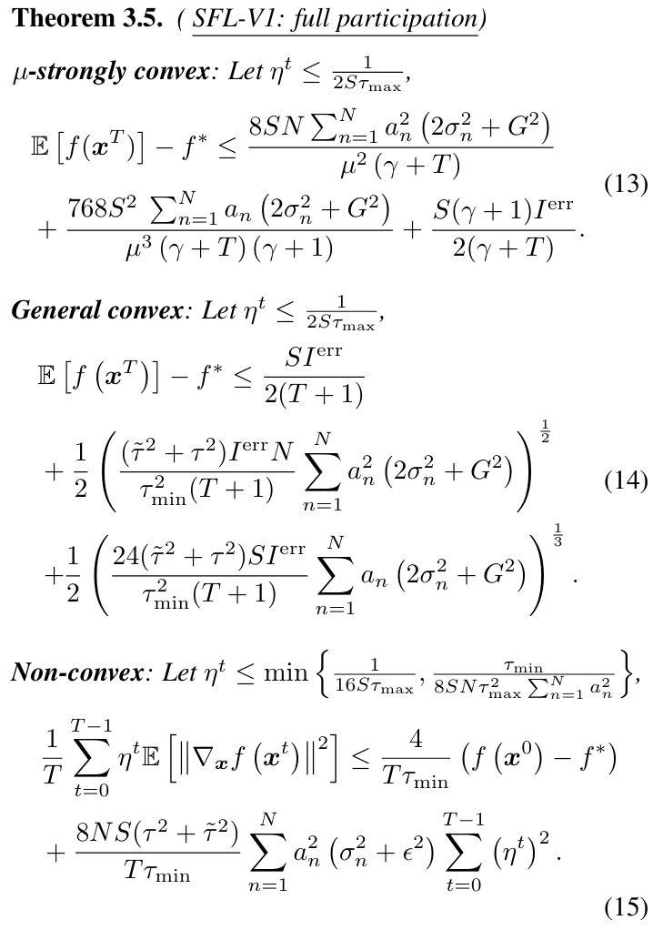
Proof

Slide 23
THANK YOU

